Slide 1
Manage workspaces and users
Manage workspaces and users

Slide 2

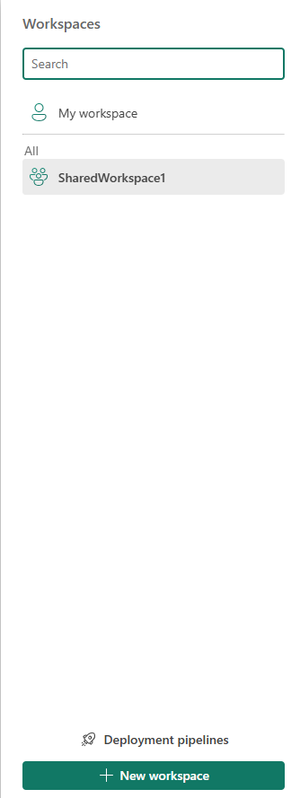
Manage workspaces and users
Note: This lab requires a Power Services account.
Create a shared workspace by selecting Workspaces and then clicking the New workspace button .
Name the shared workspace SharedWorkspace1 .

Slide 3
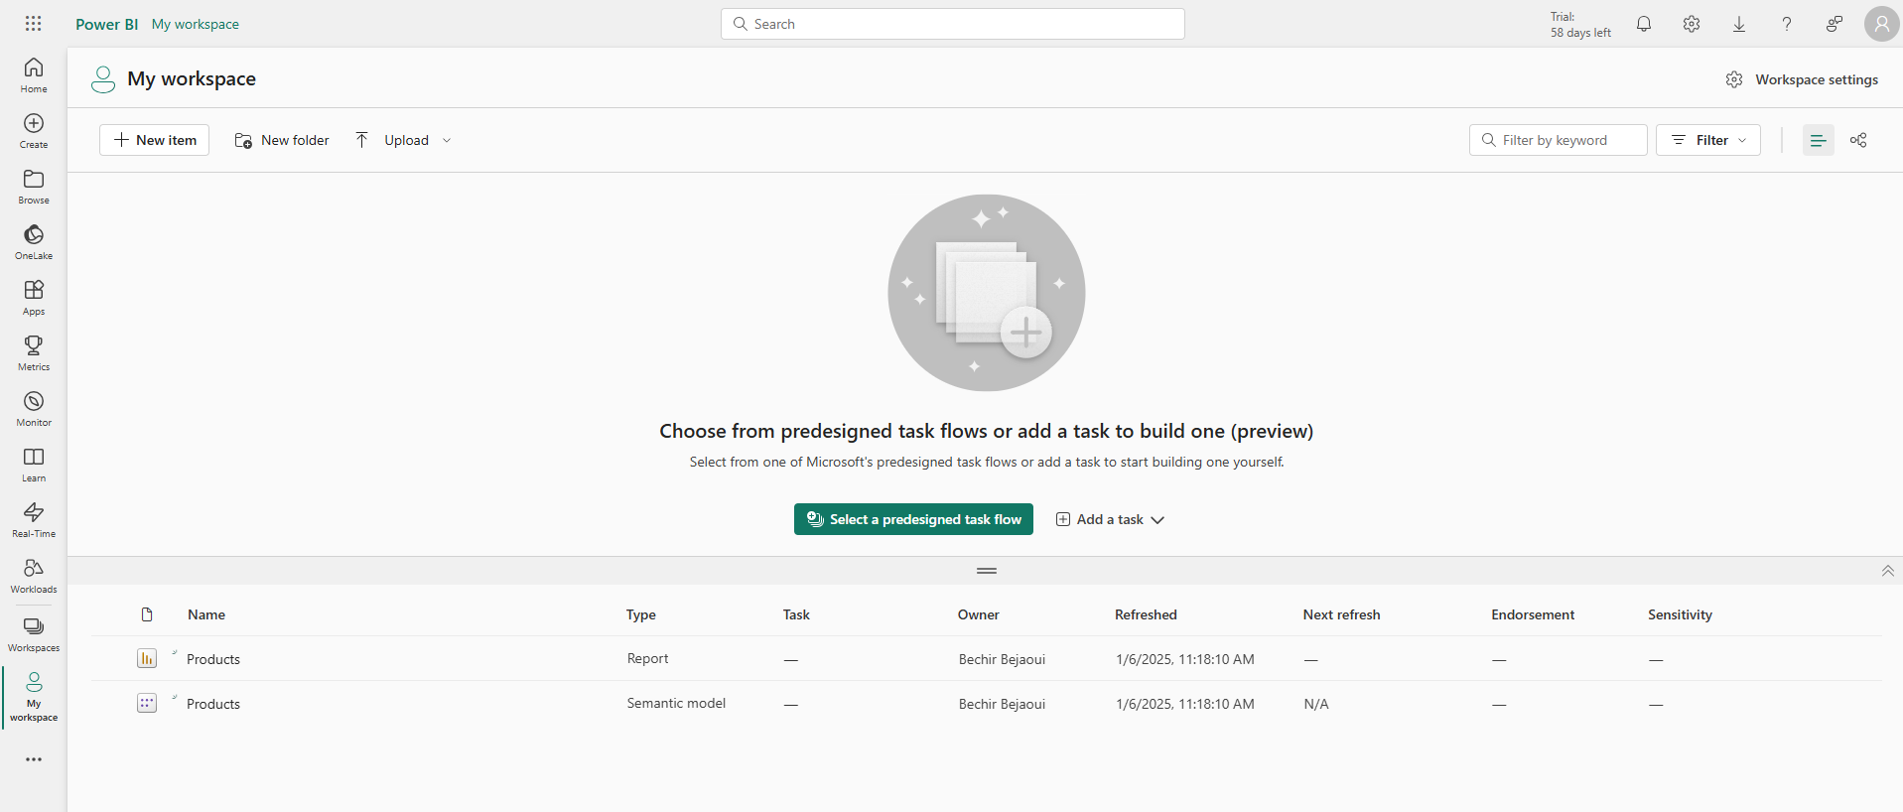
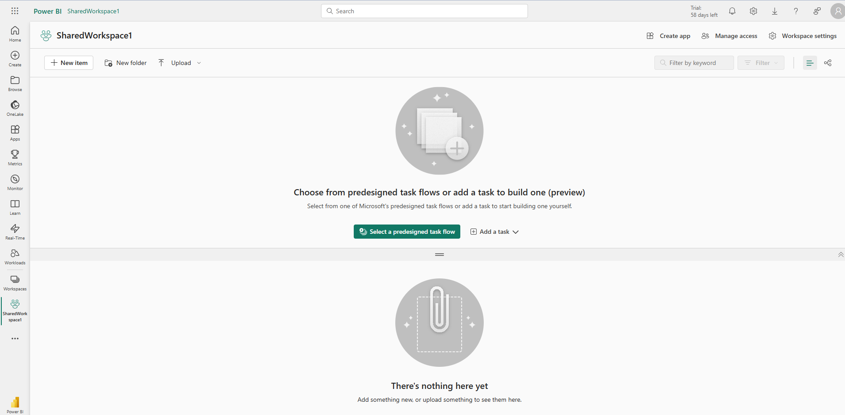
Manage workspaces and users
Compare My Workspace at SharedWorkspace1 .

Slide 4
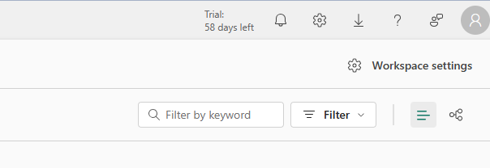
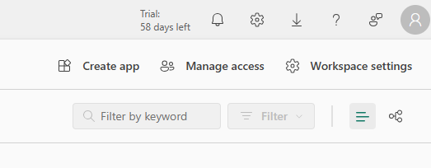
Manage workspaces and users
Note the difference between the right menus of the two workspaces.
My workspace
1
2
Shared workspace

Slide 5
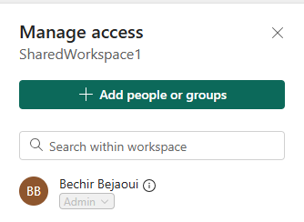
Manage workspaces and users
Click on Manage Access and note that we can add users or groups, also note the presence of the administrator.
Shared workspace

Slide 6
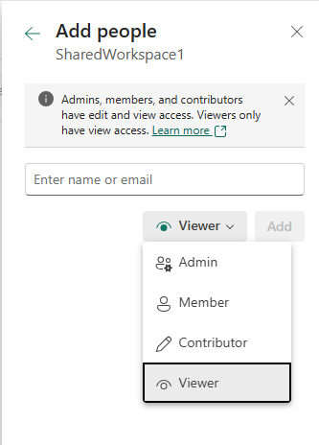
Manage workspaces and users
It is possible to invite a user to collaborate within the shared workspace and to define a profile for this user.
Admin : Full control.
Member : few edit reports/datasets
Contributor : Publish his own reports
Viewer : Few only see
1
Invite by email
2
Define a profile

Slide 7
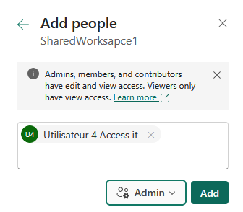
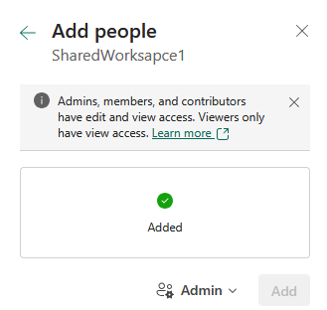
Manage workspaces and users
We can search for a user by name or email.

Slide 8
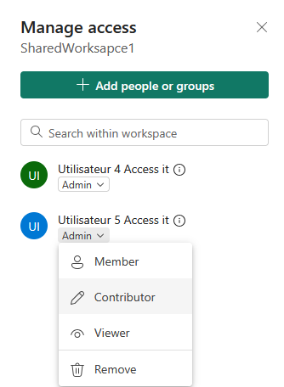
Manage workspaces and users
We can then manage users within the workspace by clicking the arrow button as follows.

Slide 9
Thank you
Thank you

